Slide 1
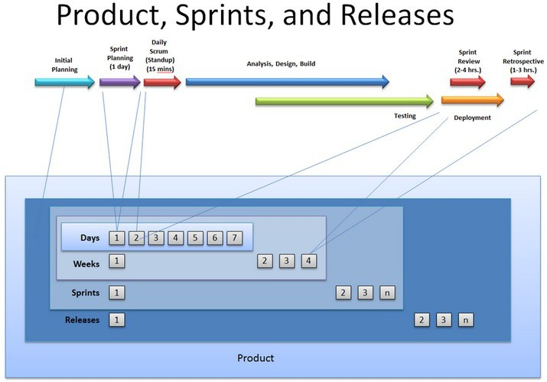
Inspect and Adept at various levels

Slide 2
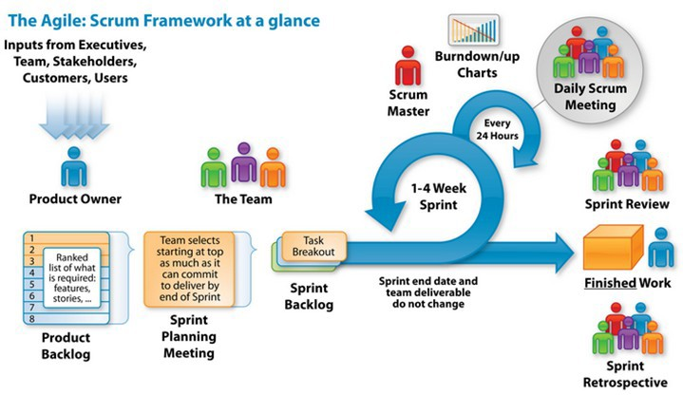
SCRUM Framework

Slide 3
Sprint Review
Purpose
❑
PO Approval or Rejection for each committed feature, story, or bug fix PO feedback for completed work
❑
Output
❑
The Product Owner must base his approval or rejection on the agreed-upon acceptance criteria for each commitment.
The Team gives the demonstration, not the Scrum Master.
The Team is held collectively accountable for failed commitments, not the Scrum Master
❑
❑
Rules
❑
The Product Owner must base his approval or rejection on the agreed-upon acceptance criteria for each commitment.
The Team gives the demonstration, not the Scrum Master.
The Team is held collectively accountable for failed commitments, not the Scrum Master
❑
❑

Slide 4
Sprint Retrospective
Purpose
❑
To reflect on what went well & what did not in the last sprint
Output
❑
List of steps to be taken for making the next sprint more enjoyable and productive
Rules
❑
No blame game or finger pointing
Everybody must contribute enthusiastically for the continuous improvement Attended only by ―pigs
❑
❑

Slide 5
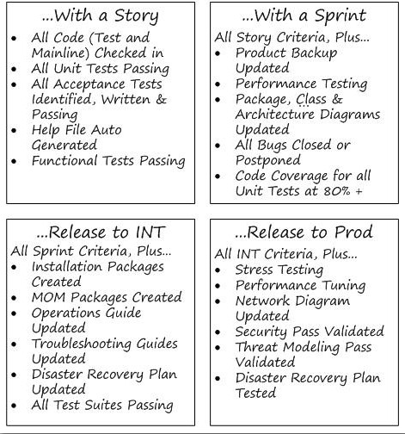
Different Definitions at Different Levels
Ultimately, the decision rests on the answer to the following three questions:
1. Can we do this activity for each feature? If not, then
2. Can we do this activity for each sprint? If not, then
1. We have to do this activity for our release!

Slide 6
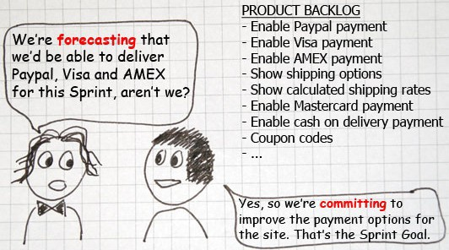
Sprint Backlog
❑
Set of Product Backlog items selected for the Sprint
A plan for delivering the product Increment and realizing the Sprint Goal.
A forecast by the Development Team about what functionality will be in the next Increment
❑
❑
❑
The work needed to deliver above mentioned functionality into a “Done” Increment.
The Development Team modifies the Sprint Backlog throughout the Sprint
❑

Slide 7
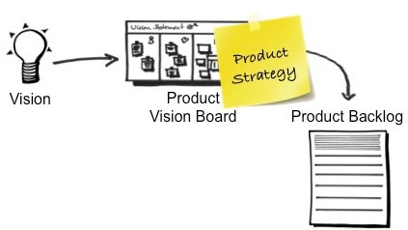
Product Vision
The product vision paints a picture of the future that draws people in for your Product. It describes who the customers are, what customers need, and how these needs will be met. It captures the essence of the product – the critical information we must know to develop and launch a winning product. Developing an effective product vision entails carefully answering the following questions:
•
Who is going to buy the product? Who is the target customer? Which customer needs will the product address?
Which product attributes are critical to satisfy the needs selected, and therefore for the
success of the product?
How does the product compare against existing products, both from competitors and the same company? What are the product’s unique selling points?
What is the target timeframe and budget to develop and launch the product? PO is responsible for creating Product Vision.
•
•
•
•
•

Slide 8
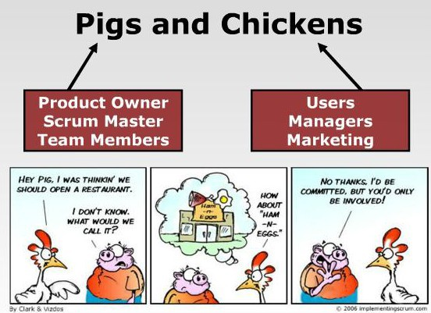
Pigs and Chickens

Slide 9
Product Owner
❑
Define the features of the product
❑
Decide on release date and content
❑
Be responsible for the profitability of the product (ROI)
❑
Prioritize features according to market value
❑
Adjust features and priority every iteration, as needed
❑
Accept or reject work results.

Slide 10
SCRUM Framework

Slide 11
SCRUM: An empirical process
Scrum is based on Empiricism or the Empirical process control theory. Empiricism asserts that knowledge comes from experience and making decisions based on what is known. Scrum employs an iterative, incremental approach to optimize predictability and control risk.
3 Pillars of Empirical Process Control:
✓
Transparency -outcome must be visible to those controlling Inspection -various aspects must be inspected frequently
Adaptation -must be adjusted if one or more aspects of the process are outside acceptable limits
✓
✓

Slide 12
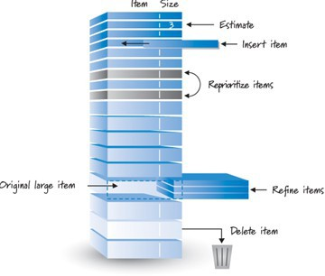
Product Backlog Items (PBIs) Characteristics
Each of PBIs should follow I.N.V.E.S.T criteria:
❑
Independent Negotiable Valuable Estimable Small Testable
❑
❑
❑
❑
❑
** Team does collaborative grooming

Slide 13
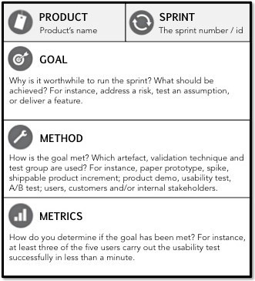
Sprint Goal
❑
The Sprint Goal is a ‘short statement’ of WHAT WORK will be FOCUSED on during the Sprint.
It contains set of selected Product Backlog items which deliver one coherent function.
The Sprint Goal is that coherence which causes t Development Team to work together.
Development Team’s, and not individual’s, focus stays on Sprint Goal.
❑
❑
he
❑
❑
Sprint Goal gives Development team that flexibility as per which they change Sprint backlog and tasks.
NOTE: If the work turns out to be different than the Development Team expected, they collaborate with the Product Owner to negotiate the scope of Sprint Backlog within the Sprint.

Slide 14
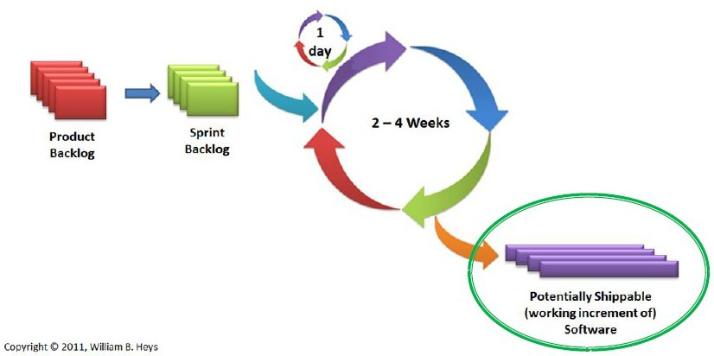
Increment
❑
The increment is sum of all Product Backlog Items completed during a sprint and, all previous sprints.
❑
At end of a sprint, Increment must be done according to Scrum Team's definition of done.
❑
The increment must be in usable condition regardless of whether the Product Owner decides to actually release it.

Slide 15
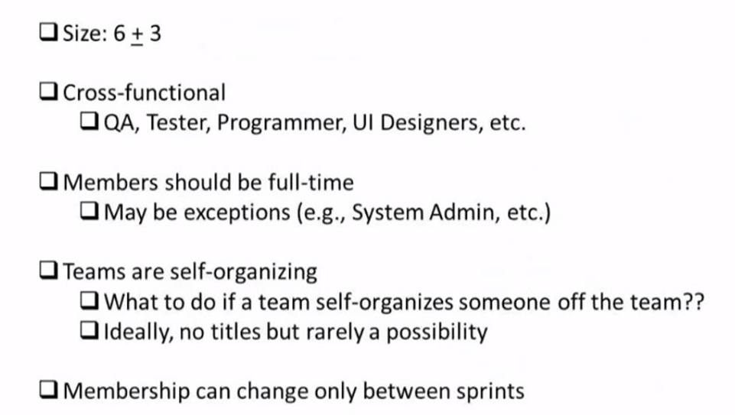
SCRUM Development Team

Slide 16
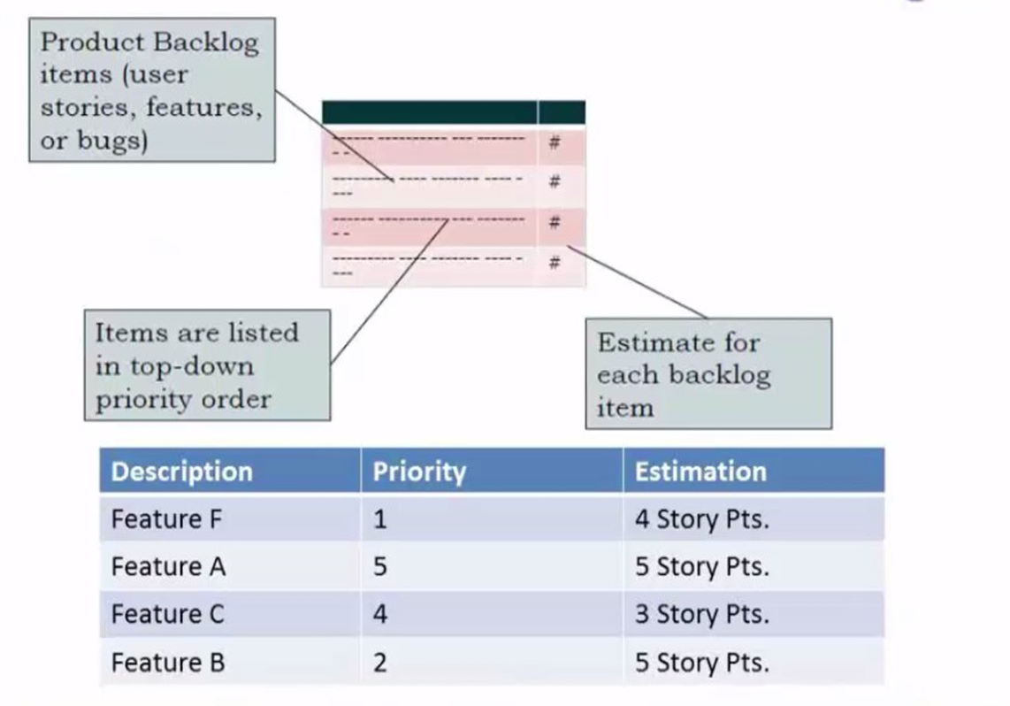
Product Backlog

Slide 17
Daily Standup (Daily Scrum)
Goal
Enable to team to share progress with each other
Make visible blocks (impediments) daily for whole team to see
Everyone stands in a circle and reports 3 things
What did I do since the last Daily Scrum Meeting?
What will I try to do by the next Daily Scrum meeting?
What are my blockades?
15 minutes maximum
No discussion or debate: listening only
After meeting ends, discuss and problem-solving can start
Team and Scrum Master only
Team can invite PO or others if they wish, but it's upto the team
After the meeting, Scrum Master leads the removal of blocks

Slide 18
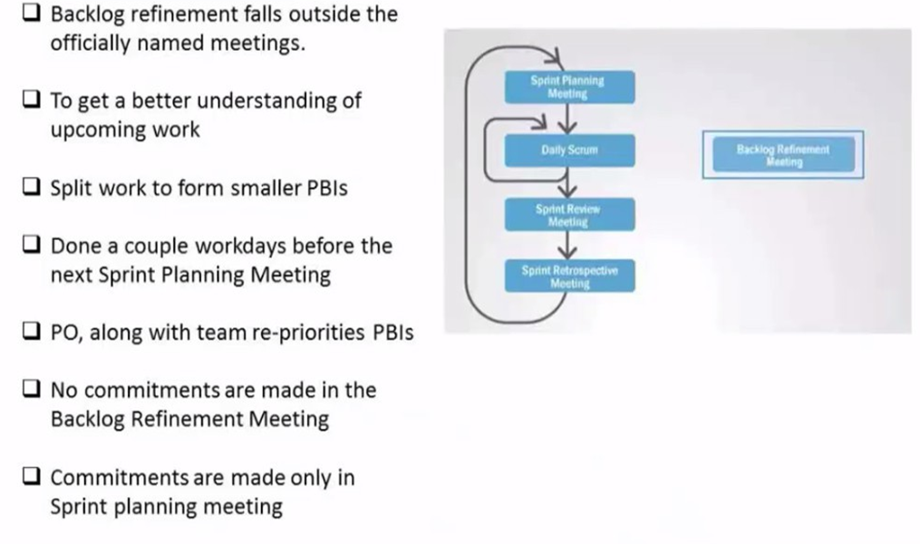
Backlog Refinement Meeting

Slide 19
Release Planning
"When will you deliver the product?"
"We can't answer this question, we are Agile!"
"But you must have some idea. At least give me a high-level plan. When should I expect the release?"
"Well, you know, In the future. That's the best I can guess at this point"

Slide 20
Release Planning
A high-level roadmap that forecasts -when wewill do what.
Owned by PO
Only PO can prioritize Backlog
Dependencies are offered by the team, must be considered
Velocity (average output per sprint) is required to know how much to forecast for future sprints
It should be as realistic as possible -Explain delivery dates as best case, worst case, most likely scenarios
It should be Fresh -Updated after each sprint

Slide 21
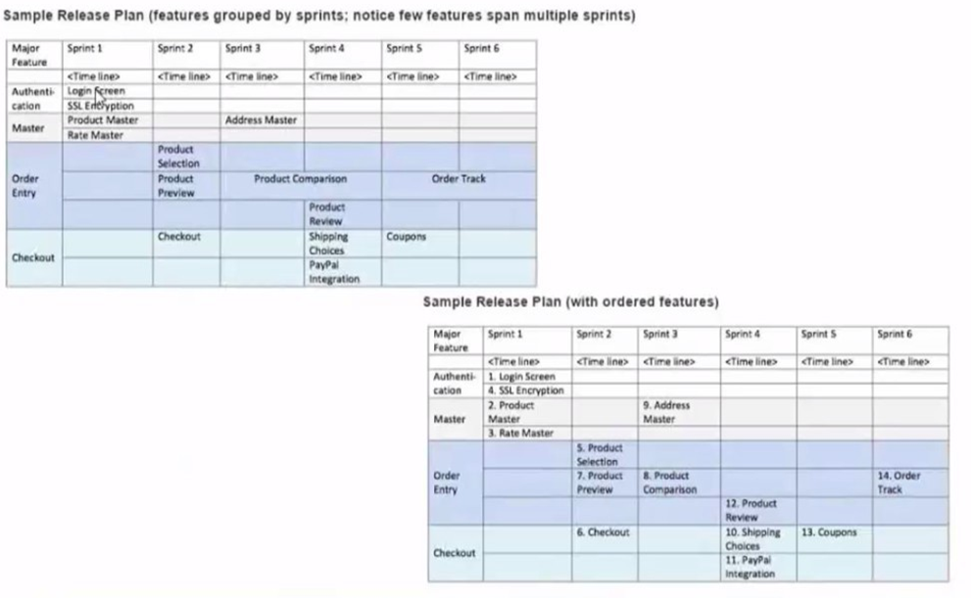
Release Planning Samples

Slide 22
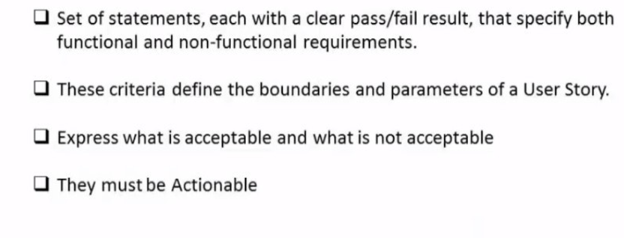
Acceptance Criteria

Slide 23
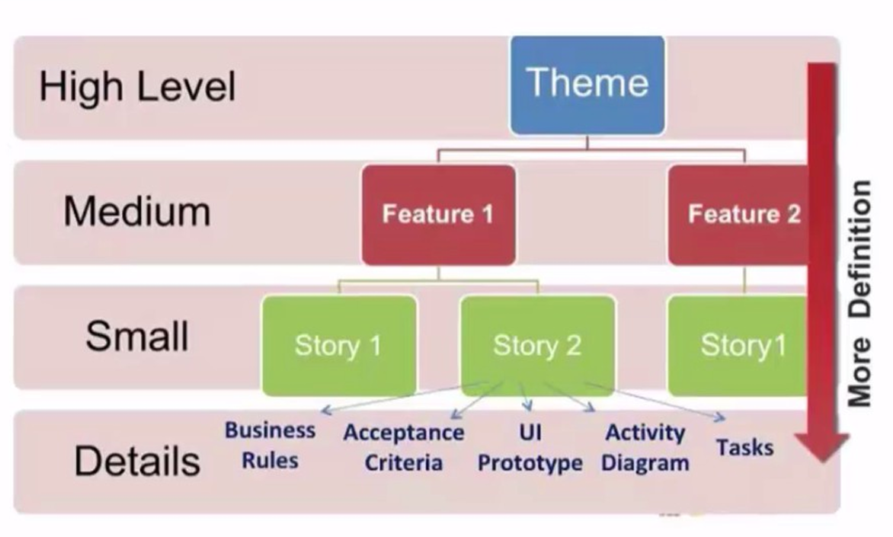
Requirements Management in SCRUM

Slide 24
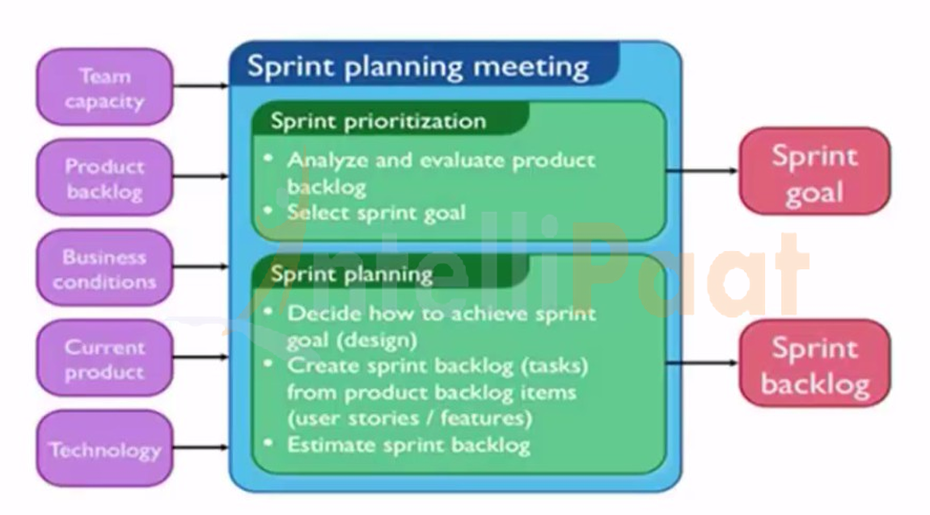
Sprint Planning

Slide 25
Definition of Done (DOD)
When a Product Backlog item or an Increment is described as "Done': everyone must understand what "Done" means
Purpose:
Enable time estimations. If you don't know what people mean by done asking them for an estimate is pointless.
Avoid misunderstandings. When having conversations about progress, work
being done, and so on, shared definitions help avoid misunderstandings and disagreements.
Assure quality. The DoD ensures quality and helps avoid technical debt by including test cases, refactoring, code documentation, and so on.
Properties:
The DoD is dynamic. Evolve with team's learning. Shared with all to ensure transparency.
If not entirely, a lowest common denominator of the DoDcan be the same across teams, in a multi level Scrum implementation.
The level of sharing also depends on at what level the DoDis used.

